Slide 1
Introduction
What is Devops
DevOps Models
WaterFall model
DevOps Model
DevSecOps Model
What is Cloud
Evaluation of infrastructure till cloud
Physical Servicer
Hyper V
Cloud
What is azure DevOps
Roles of DevOps Engineer
Infra Structure Creation/Support
Resolving operational Issues
Network related issues
ITIL
Automation
Linux Support
Automation script writing
CI/CD
Containerization
Deployments.
Carrier options of Azure DevOps engineer.

Slide 2
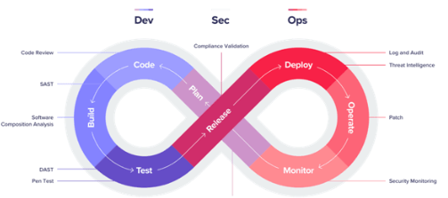
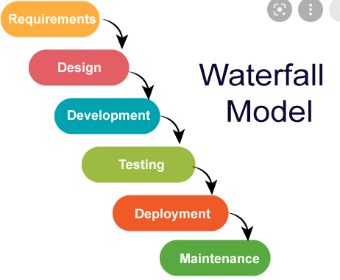
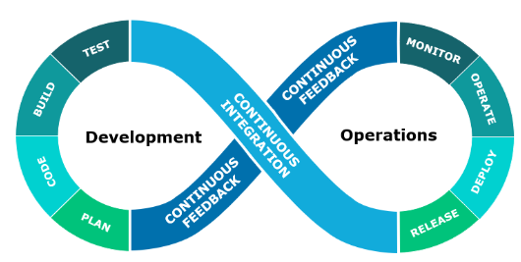
Devops: It is a community name which is given by software as devops.
By interacting the developers and operations.
We do lot of automation.
We have a lot of tools in the market.
Waterfall model vs devops model vs DevSecOps model:
identities

Slide 3
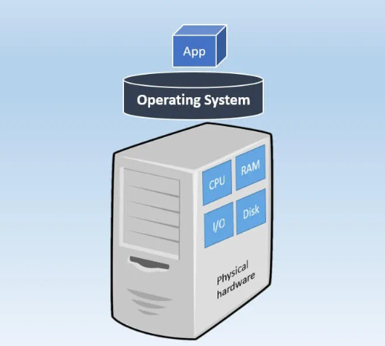
Physical Server:

Slide 4
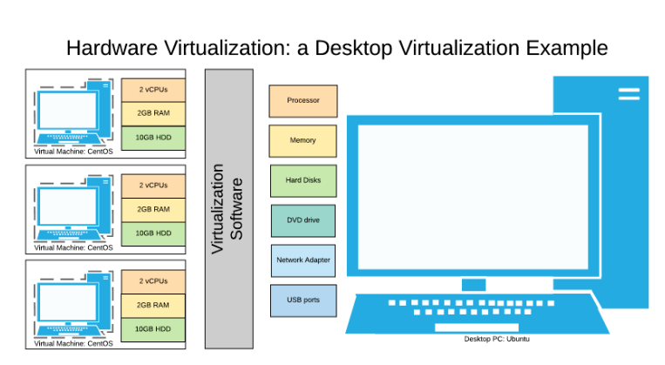
Virtualization:
→ Started at 1960

Slide 5
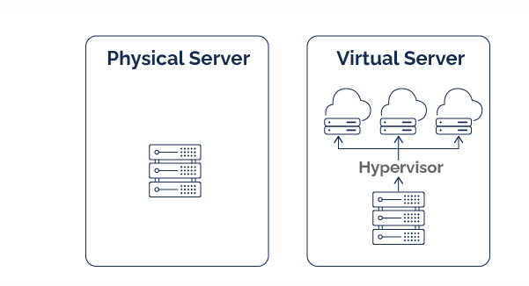
Physical server and virtualization:

Slide 6
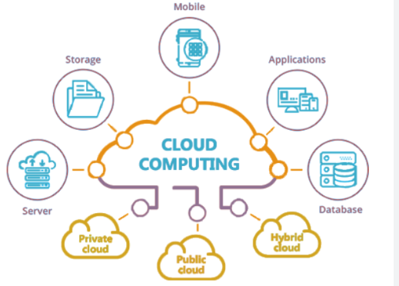
Cloud:

Slide 7
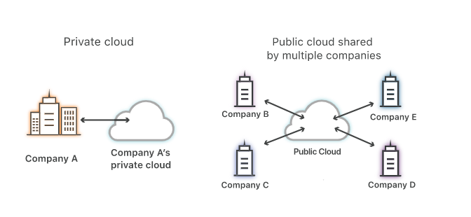
Public Cloud/ Private Cloud:

Slide 8
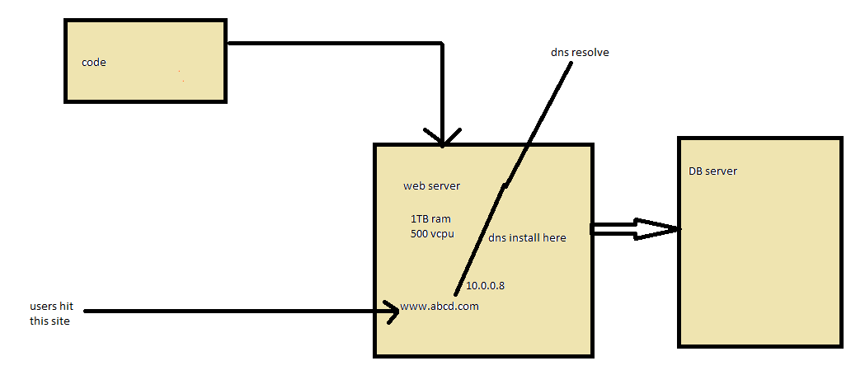
Cloud: Every one is implementing the devops practices in the organization.
It is nothing but a servers with some software it becomes like resources, those we will utilize in our day to day activities.
Cloud computing:
Elabaration of cloud computing:
Basic infra structure.
Physical server
Virtualization (vm ware, citrix, hypervisior)
Cloud
Types of cloud: 3 types
Public cloud
Private cloud
Hybrid cloud

Slide 9
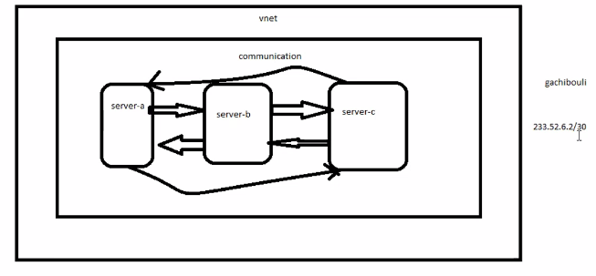
The first cloud which introduced is sales force. In year 2000’s. but it is saas based cloud
The public cloud intruded by aws in 2006 march 3.
Azure introduced on 2010 feb 1.
Region:
Zones:
DataCenter:
Internet/ intranet
Create azure Account
Azure cloud architecture
Difference b/w resource and services.
About azure UI (all shortcuts, search, temp storage)
Ways to connect to azure
Cloud shell
Install of az cli, powershell
RG
Tags
Paas, IAAS, SAAS
Networking
LAN
Internet application/intranet applicaiton

Slide 10
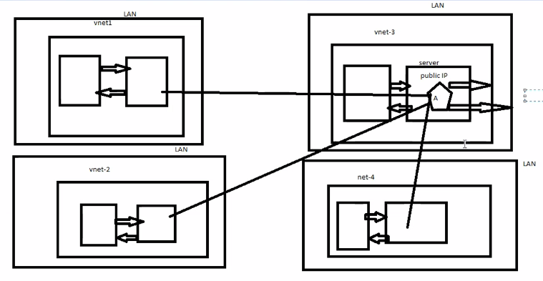

Slide 11
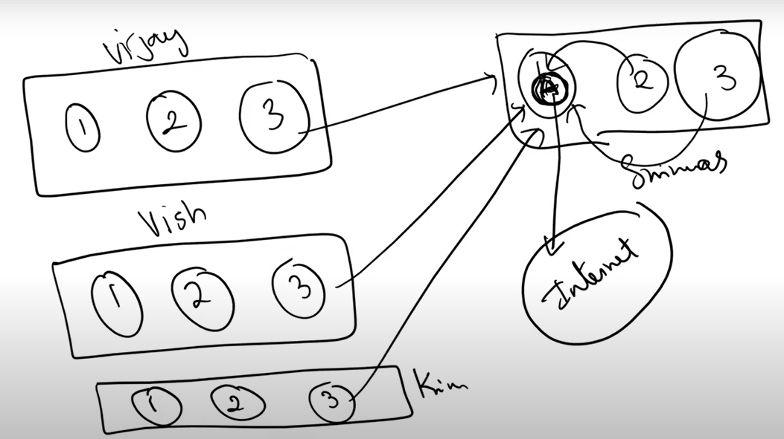
Internet applications:

Slide 12
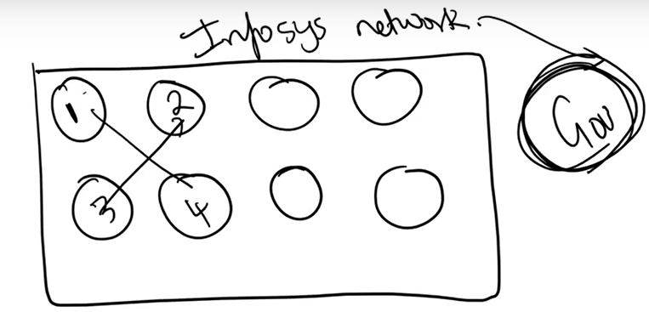
Governed network:

Slide 13
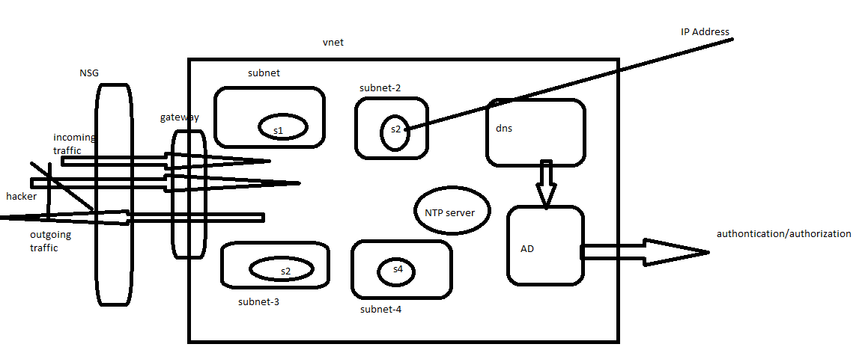

Slide 14
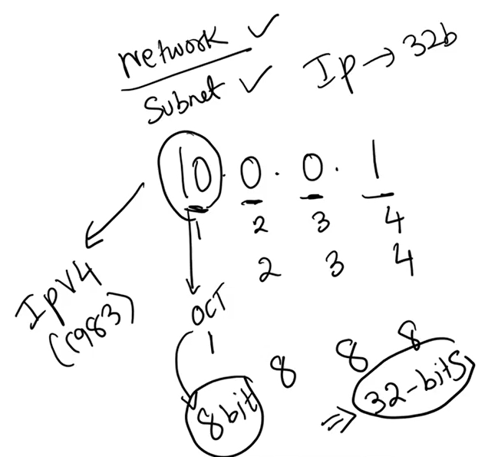
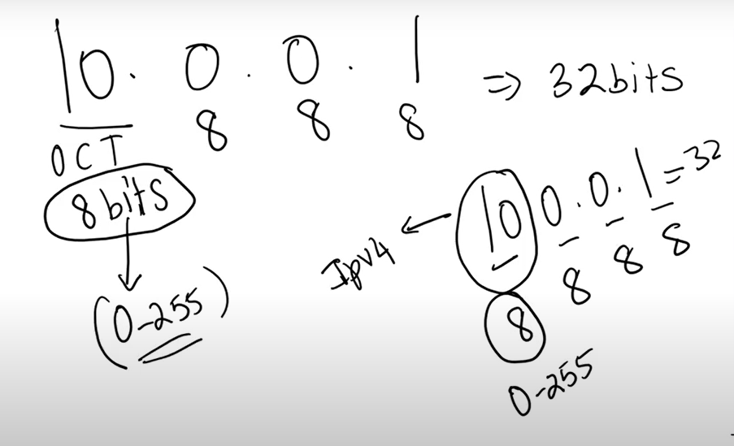
lPV4:
CIDR
Octet → each number in ip is octet . Each octet contains 256 ip address
10.0.0.0/24 → 10.0.0.0/24 bits are fixed [first 3 octet are fixed.
formulae

Slide 15
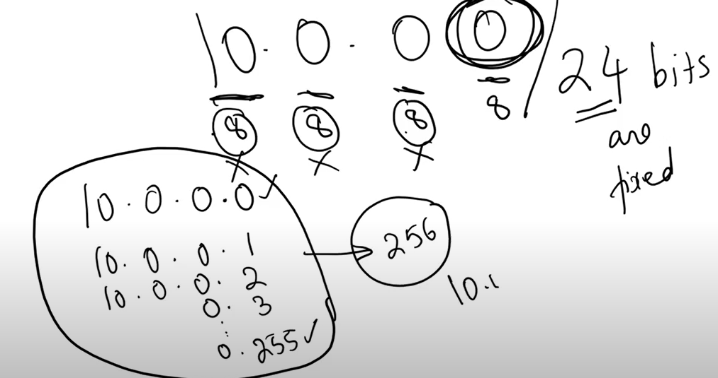
CIDR:

Slide 16
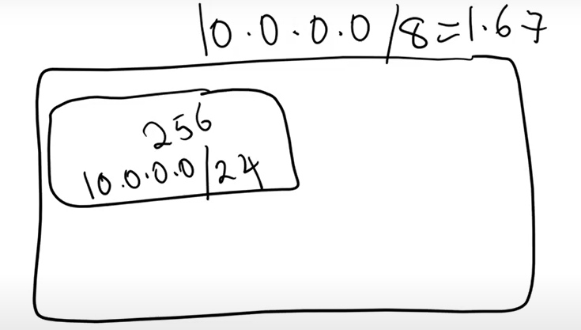
2^n-k
n= total ips
K= required ip
Class-A → 10.0.0.0/8
Class B → 172.16.0.0/12
Class C → 192.168.0.0./24
System IP addresses:
10.0.0.0 : Network address
10.0.0.1 : Reserved by Azure for the default gateway
10.0.0.2, 10.0.0.3: Reserved by Azure to map the Azure DNS IPs to the VNet space
10.0.0.255 : Network broadcast address.
IPV6: it is like a big network.

Slide 17
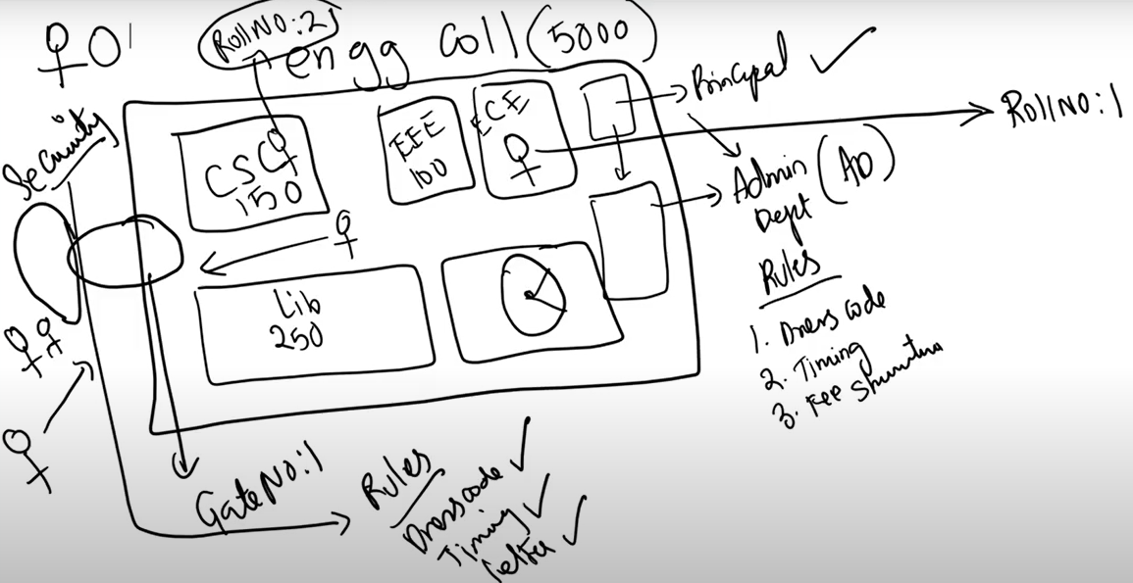
Network:

Slide 18
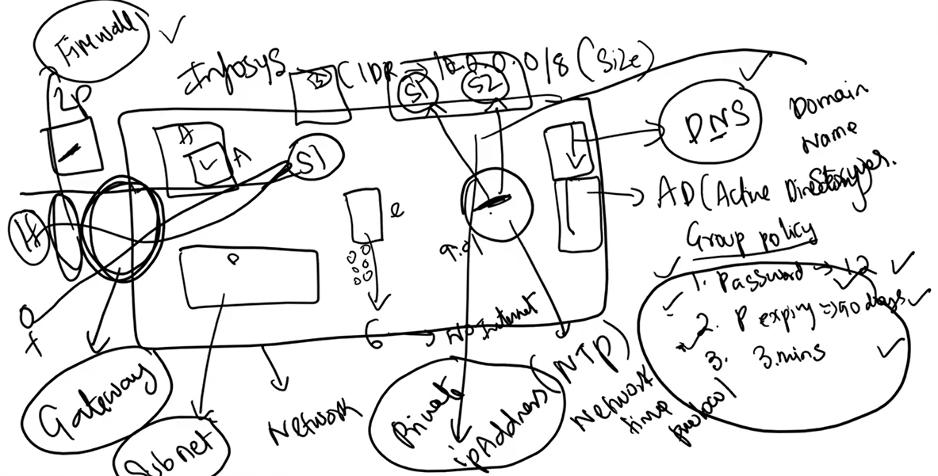

Slide 19
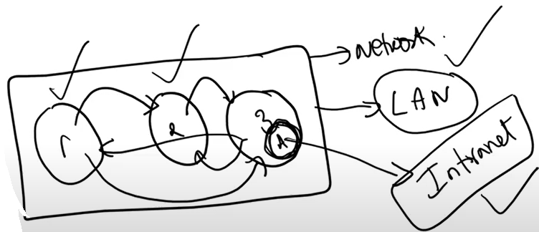
Vnet:
Vnet is nothing but we are going to work on networking on Azure.
Using Vnet we can expose your servers to internet/intranet.
Networking:
Using network we can communicate the server/resources which are there in the azure.
Network is mandatory to create a server or anything in even office. Without network we can’t create anything. Eg: ipconfig, ifconfig.
LAN: local area network
Intranet applications:

Slide 20
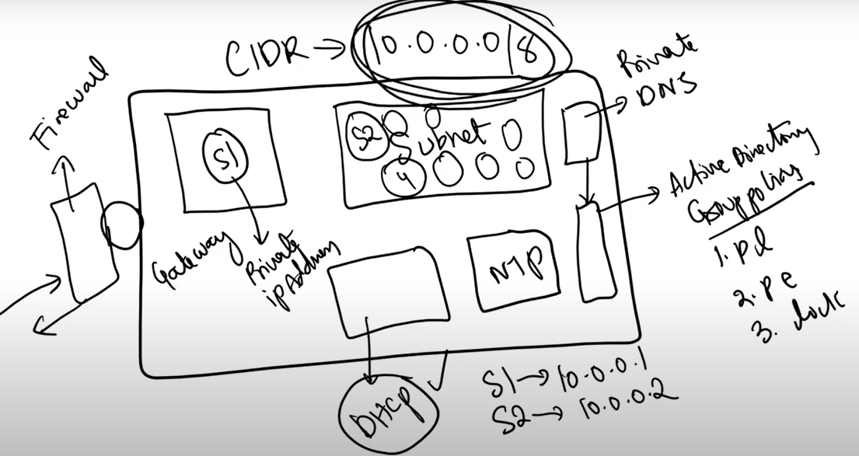
DHCP:

Slide 21
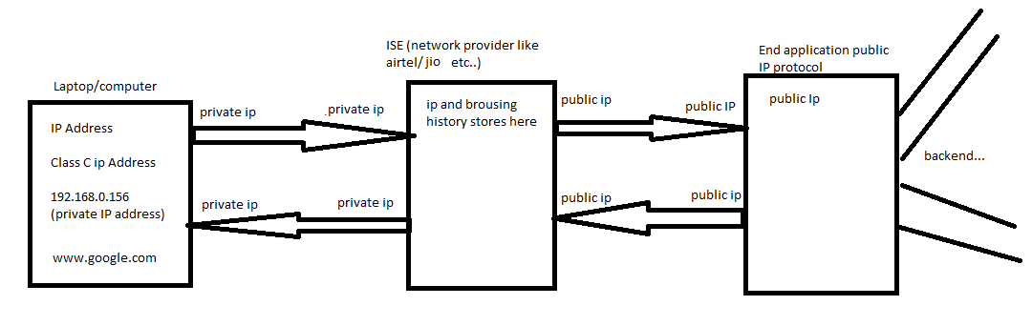
How internet work in local laptop:
Public IP/Private IP:
Class –A, class-B, class-C 10.0.0.0/8, 172.16.0.0/12, 192.168.0.0/24

Slide 22
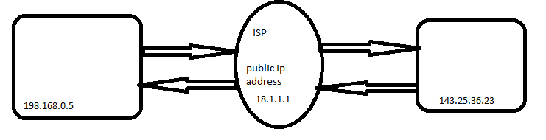
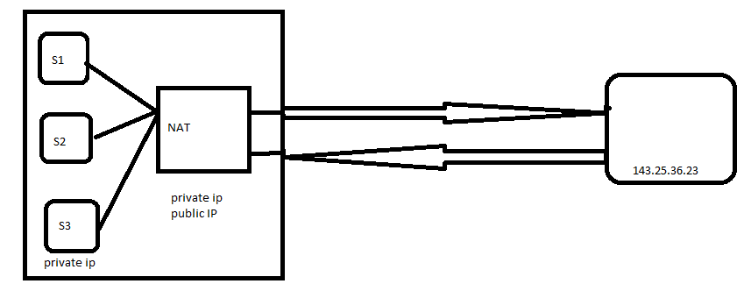
How internet is working/ ISP:
Every region we have one ISP ip address
How do we know your ISP ip address: type what’s my ip address.
NAT:
Private server we won’t get internet. For getting internet to the private server we need to use NAT.

Slide 23
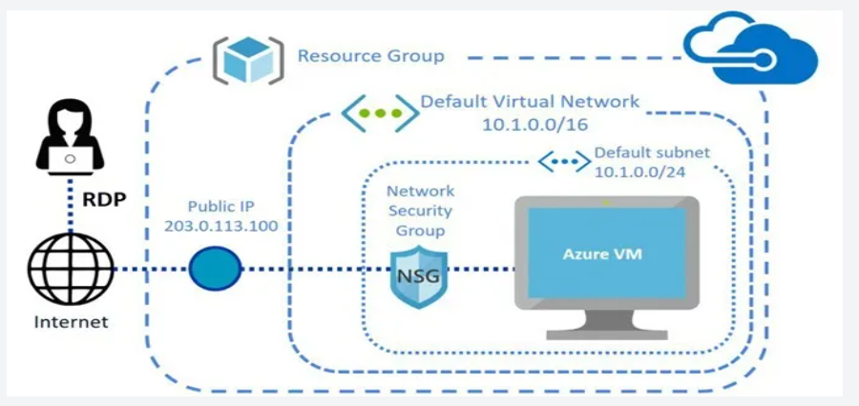
Nsg:
Service Tag:
ASG: This helps lot more flexibility how we define our security.
First we need to attach the ASG to VM,
Using the asg we can create inbound or outbound security rules.

Slide 24
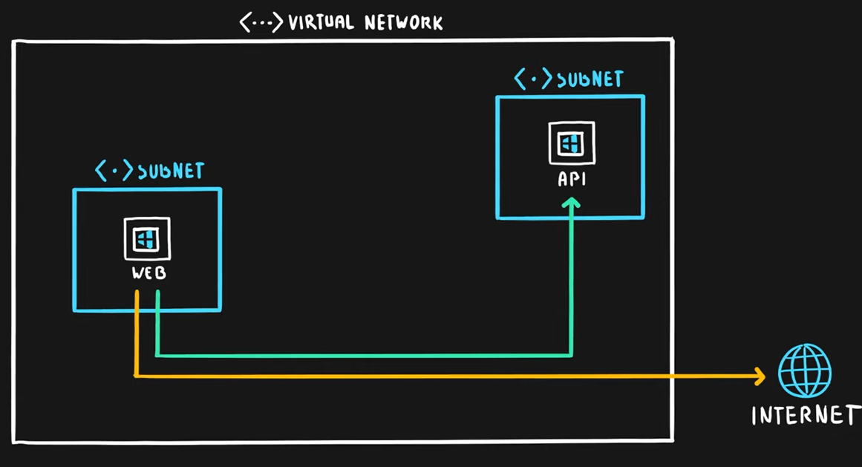
Route table:
Process of selecting a path for a traffic for one of the multiple networks.
2 tyeps:
System defined route: default routes
User defined route (UDR): want change route
Create a route table
Associate your subnet (public subnet)
Then add the route
name: name of the route
Address prefix: target address prefix (api server subnet)
Next hot type: virtual applicance
Next hop address: nva server.
→ Go to web server and hit tracert api (now it will go though nva server)

Slide 25
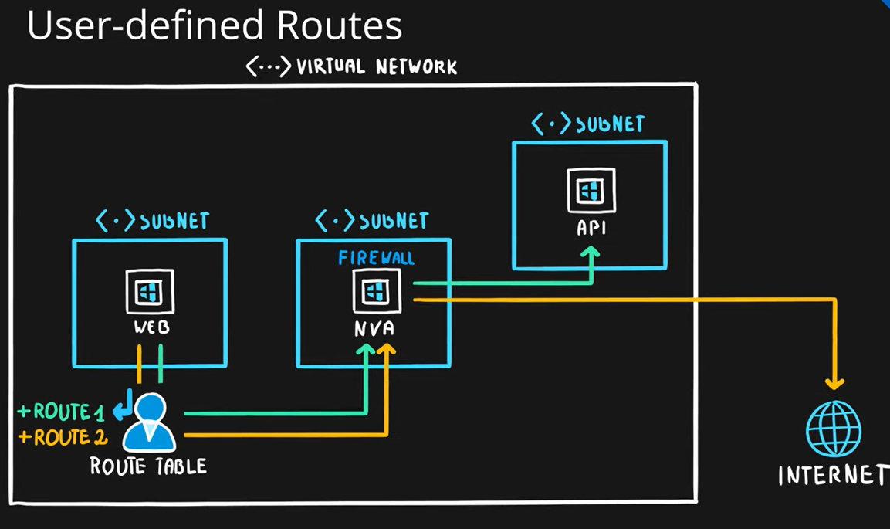
UDR:

Slide 26
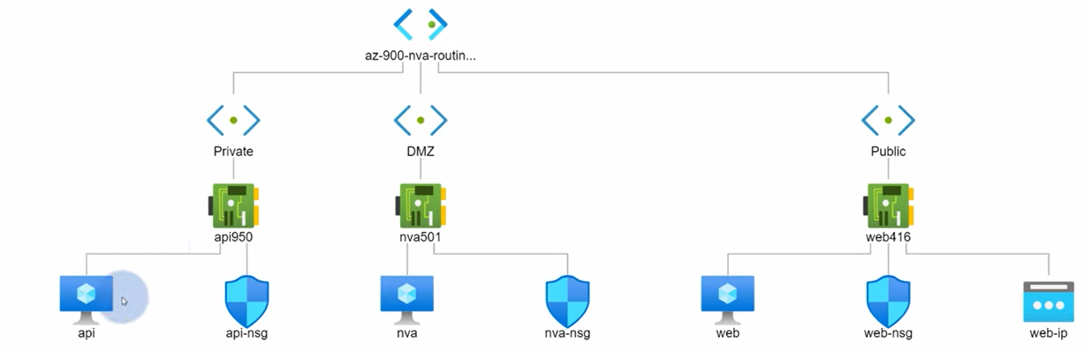
Flow Diagram:
We will use route table from redirect the traffic from web server to api server via nva server.
sudo apt-get update
sudo apt-get install -y traceroute
sudo apt-get install -y traceroute

Slide 27
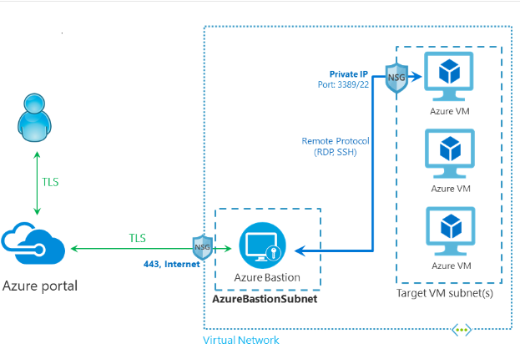
Bastion Host:

Slide 28
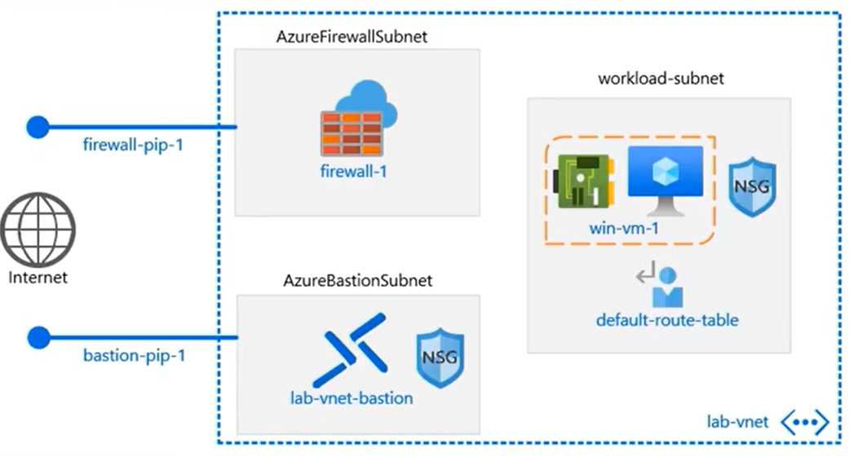
Azure Firewall:

Slide 29
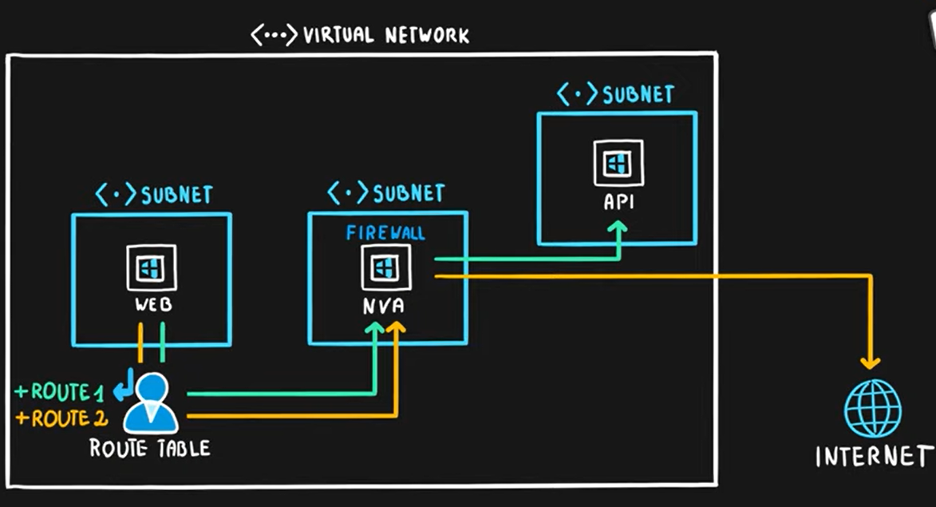
Azure Firewall:
Firewall is network security service that allows customers to monitor both incoming and outgoing traffic.

Slide 30
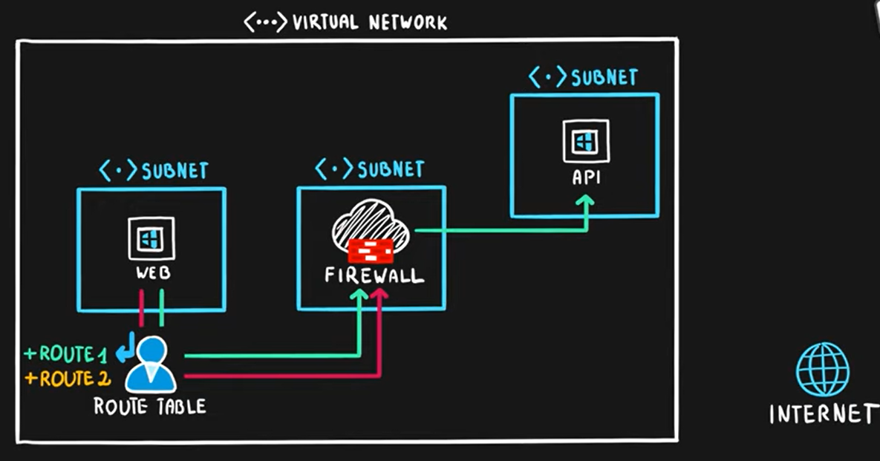
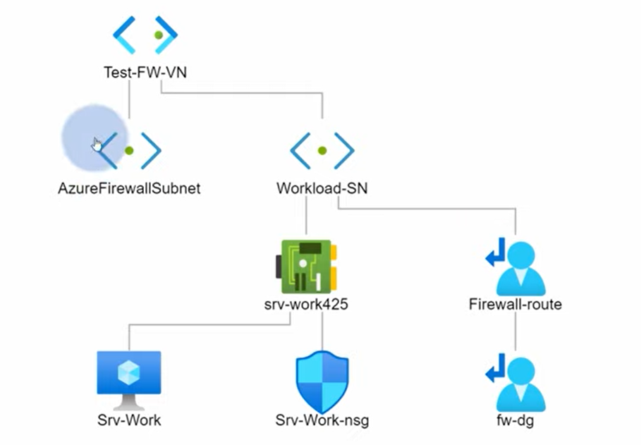

Slide 31
Process:
Create vnet and create 3 subnets bastionsubnet, workloadsunet, firewall subnet.
Create the bation host.
Create a vm without public ip
Create azure firewall with firewall subnet.
Login the vm with bastion option
Go to vnet and add the server 8.8.8.8, 8.8.4.4, 168.63.129.16
In firewall → network rule → create new rule → souce is workloadsubnet
Go to application rule → new rule → source as workload bunet → name is powershellgallary → protocol as http,https → mention the fqdn
Create the route table
Associate workflow subnet to the route table
Create a route
Name: route to firewall
Address: ip address
Destination: 0.0.0.0/0
Next hope: virtual applicance
Next hop address: azure firewall address.

Slide 32
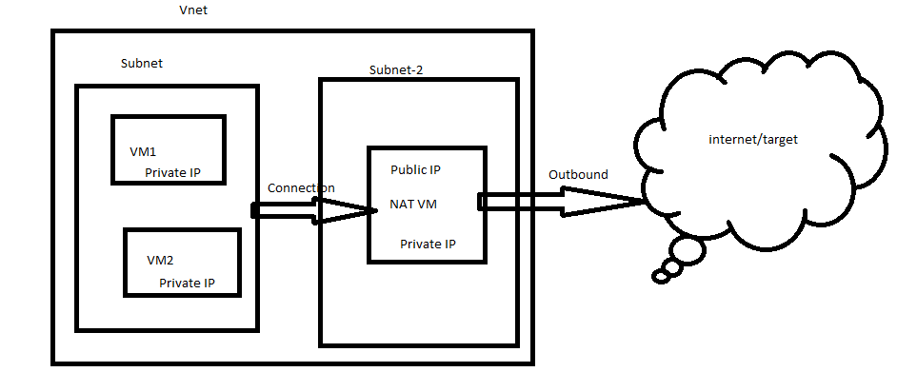
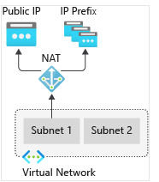
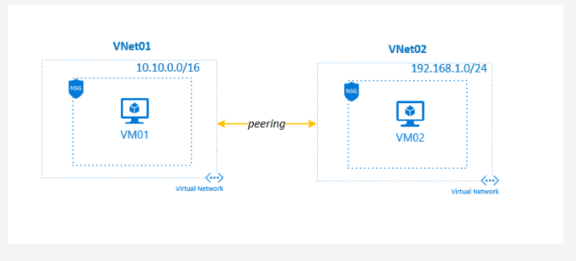
NAT role is similar to ISP. NAT is not acts like load balancer. NAT is not a mediater at all.
dig +short myip.opendns.com @resolver1.opendns.com or type what is my public ip address in the bastion host web page.
Ubuntu 18.04
NIC
Public IP:
Vnet Peering:

Slide 33
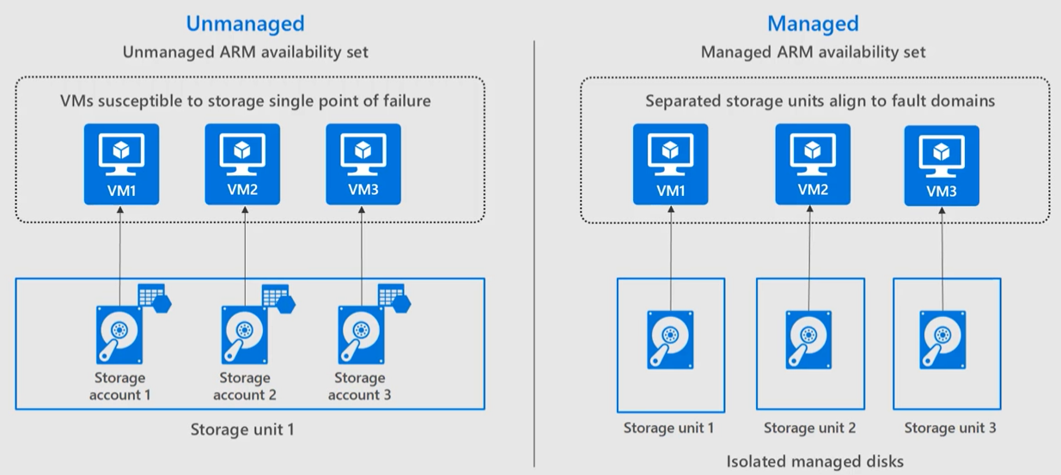
Azure Managed Disks:
Traditional way to create the storage in azure is storage account.
The storage account has some limitations as it only supports upto 20000 IOPS. And we can create upto 250 storage account.
That means we can’t keep more than 40 VM’s in a single storage account. The is a IOPS crunch.
Managed disk provides us the better performance, because we don’t need to worry about the storage limits (IOPS).
It can support upto 20000 disks per subscription. 10k standard and 10k premium disks can be supported.

Slide 34
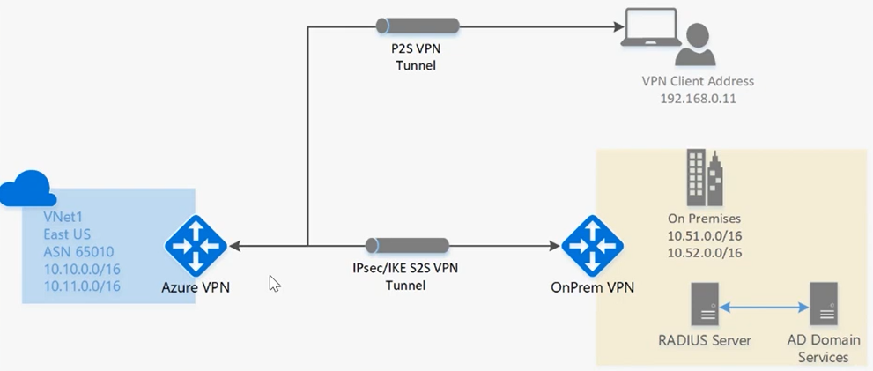
Azure VPN:
It is basically a encrypted tunnel to transfer traffic, it is a private network to connect azure machines to other networks (on-premisis).
It travels through public internet but it is encrypted.
It follows the client server architecture. The on-prem servers has to install the vpn softwares. Then on-prem and azure network will connect with help of vpn gateway.
Once connect we can access the on-prem servers using private ip addresses.
We have 3 types of vpns.
Point to site (P2S): It is used when we have less clients in on-prem servers.
Site to site (s2s): This mostly used in the office environment. We need to configure the vpn devise for this.
ExpressRoute: Special type what Microsoft providing to us.

Slide 35
Virtual Network Gateway:
It is special type of virtual network gateway that used to send the ecrypted traffic b/w azure virtual network and on-premises traffic over the public internet.
P2S LAB: create virtual network gateway.
Vpn type:
Route based: this one we used to configure the p2s or s2s.
Gateway subnet: this is special type of subnet which used on the azure vpn services.
Public IP: It is because the data only will go through public network. But it is encrypted.
Go to vnet gateway → point to site configuration.
Address Pool: This works like DHCP. Once you are connected on-prem machine to azure machine with vpn client software then this pool will gives you an ip address. That means azure will give one ip to you on-prem (client) machine.
Tunnel type: IKEv2 and sspt (ssl)
Authontication type: azure certificate. It requires for authentication on-prem and azure server.
Generate Cert:
$cert = New-SelfSignedCertificate -Type Custom -KeySpec Signature `
-Subject "CN=P2SRootCert" -KeyExportPolicy Exportable `
-HashAlgorithm sha256 -KeyLength 2048 `
-CertStoreLocation "Cert:\CurrentUser\My" -KeyUsageProperty Sign -KeyUsage CertSign
→go to manage user certificate → personal → certificates → check the p2srootcert.
https://learn.microsoft.com/en-us/azure/vpn-gateway/vpn-gateway-certificates-point-to-site

Slide 36
Client cert:
New-SelfSignedCertificate -Type Custom -DnsName P2SChildCert -KeySpec Signature `
-Subject "CN=P2SChildCert" -KeyExportPolicy Exportable `
-HashAlgorithm sha256 -KeyLength 2048 `
-CertStoreLocation "Cert:\CurrentUser\My" `
-Signer $cert -TextExtension @("2.5.29.37={text}1.3.6.1.5.5.7.3.2")
→go to manage user certificate → personal → certificates → check the p2schildcert.
Now export the root cert:
Right click on cert →All tasks → export → next → next → choose “Base-64” → next → brouse (locate in desktop) → save. → open cert with notepad→ copy only keys.
Now go to portal →paste the keys in the rootcert.→ save.
Now export the child cert
Right click on cert →All tasks → export→ select “yes, export private key” → next→ providepassword → choose path → save. (make sure saved like .pfx formate)
Now go to portal “Download VPN client” and save in local machine. → unzip it → Go to Widows Amd64 → install it.
Now (local) → setting → network and internet → vPN → you will see the vpn client → click on connect
Checking;
Local → cmd → type “ipconfig/all” → we can find the azure ip there.
(Or) we can check in wifi option we can see the vpn there.
** control panel → network and internet → network sharing center → adapeter settings → we can notice adopter called hub vnet → status

Slide 37
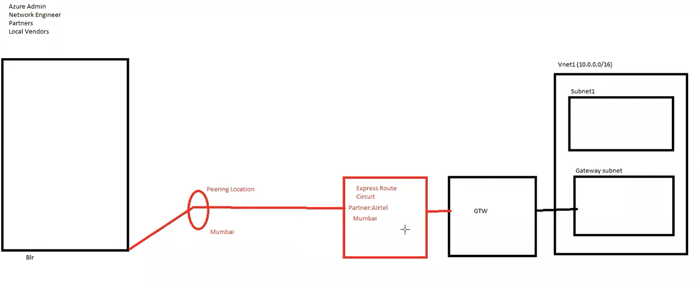
Express route:

Slide 38
Express route:
It can provide complete end to end private network transfer. It will only transfer through privately.
Azure or microsft alone can not provide express route. They need help from Partners.
Partners: It is like any telecom companies in the world. Microsoft tied up with them and making the express route connectivity.
Partners will extend network upto a certain location eg: Mumbai, Chennai etc..
Peering location: Partners till where they extend the private network we called as peering location.
After peering location we use local providers to connect network from the peering location to the main on-prem data center. We need to provide the contract to local network providers to establish that connection.
From azure admin side: we need to create express route circuit. After creating we need to use the service key, and get the connection. Once we got the connection status of the peering will be provisioned.
After it got provisioned, create virtual network gateway.
Then open virtual network gateway and try to add the connection it will not connect.
Note: Without provisioned the express route peerings we can not create connection in virtual network gateway, it will gives us error.

Slide 39
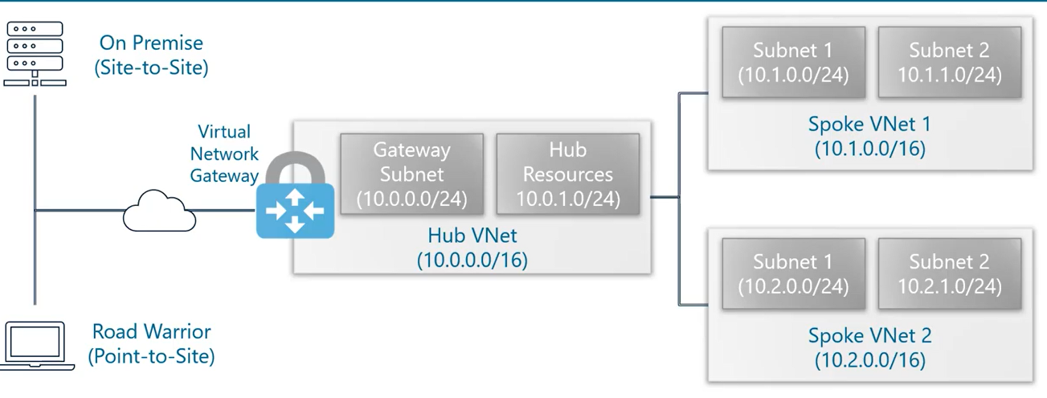
Hub and spoke:

Slide 40
Storage:
Blob: We can store unstructured/nosql data
File: We can store unstructured/nosql data
Tables: We can store structured/nosql data
Queues: We can store structured/nosql data
Performance:
Standard
Premium.
Kind:
Storage
Storage v2
BlobStorage
Access Tier:
Cool
Hot
Replication:
LRS
ZRS
GRS
Zone-geo

Slide 41
Disks: We have 2 types.
Managed disks: These are azure managed disks. That means the backend storage will be there with azure, not the azure storage accounts.
Unmanaged Disks: These built on top of storage accounts.
Unmanaged disk: We need a storage account first. Then we can create disk, and the url like https://storageaccount.windows.net/<container>/disk.
Limitations of unmanaged disk:
It only supports upto 20000 IOPS per storage account. We can’t keep not more than 40 VM’s in a storage account due to each vm contains upto 500 IOPS.
Managed Disk: The backend storage will handled by storage accout.
It provides better performance due to we don’t need to worry about storage account limits.
It will support upto 20000 disks for each subscription which can be 10000 standard and 10000 premium disks.

Slide 42
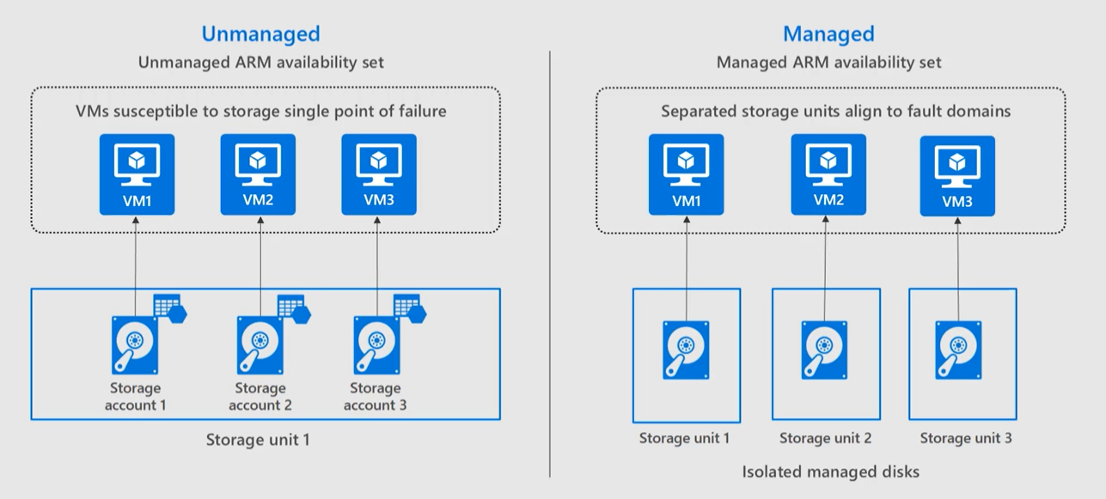
Main difference:
→ Create the Lab

Slide 43
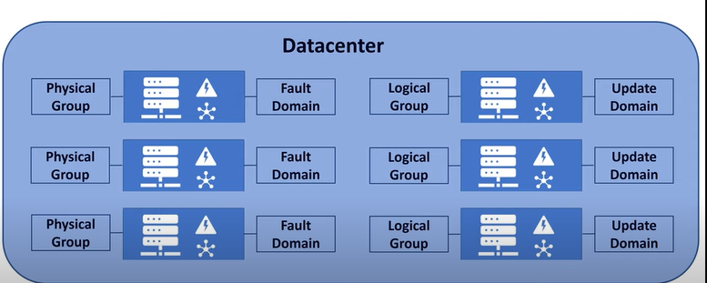
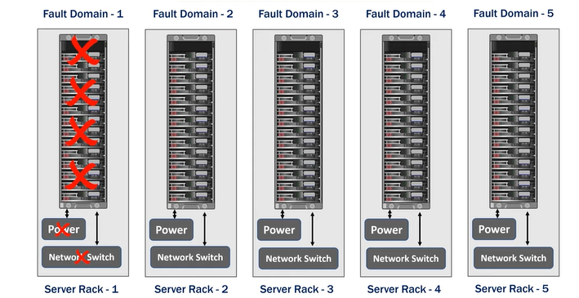
Fault Domain and update domain:
In datacenter each rack of servers will have its own power supply and network switch.
Each rack in datacenter is one fault domain. This required for eliminating the single point of failure. Eg: if only one switch, if that gone, entire datacenter servers will gone.
Update domain.

Slide 44
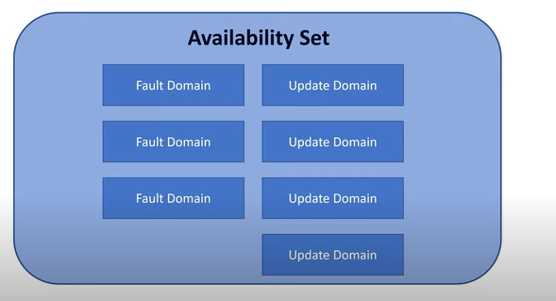
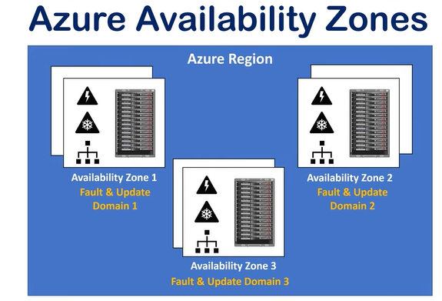
Update domain: This requires for software updates.
Note: Each server we create contains multiple fault domain and update domains.
Availability set:
Availability zone: Not all regions will have zone or availability zones. It is like same region one or more datacenters will be there.

Slide 45
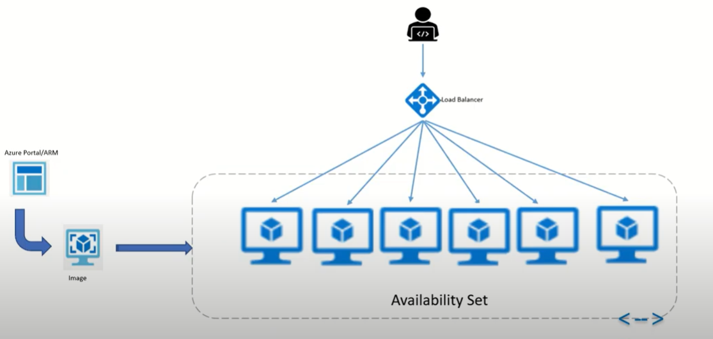
Availability set:
Availability sets resides in single datacenter but 3 different locations.
Auto scaling is not there here.

Slide 46
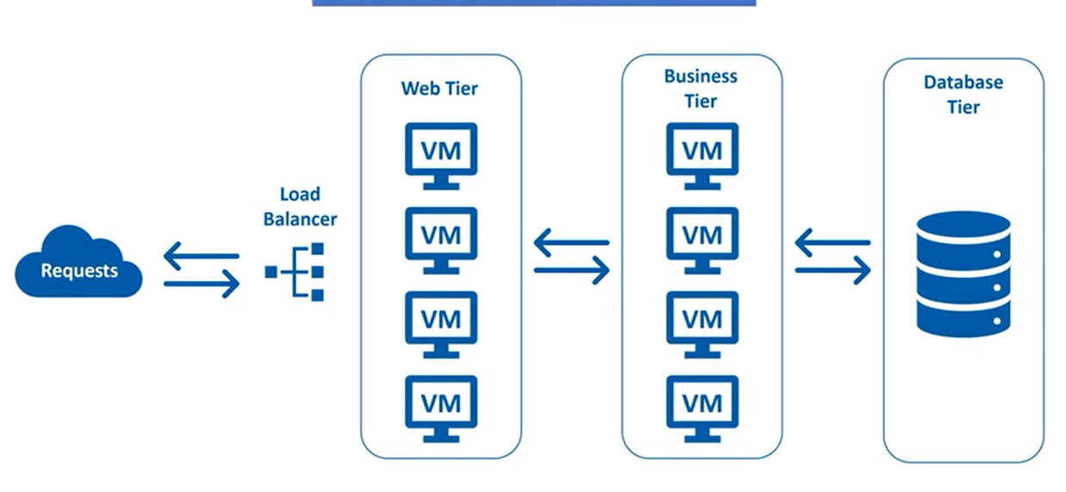
VMSS:

Slide 47
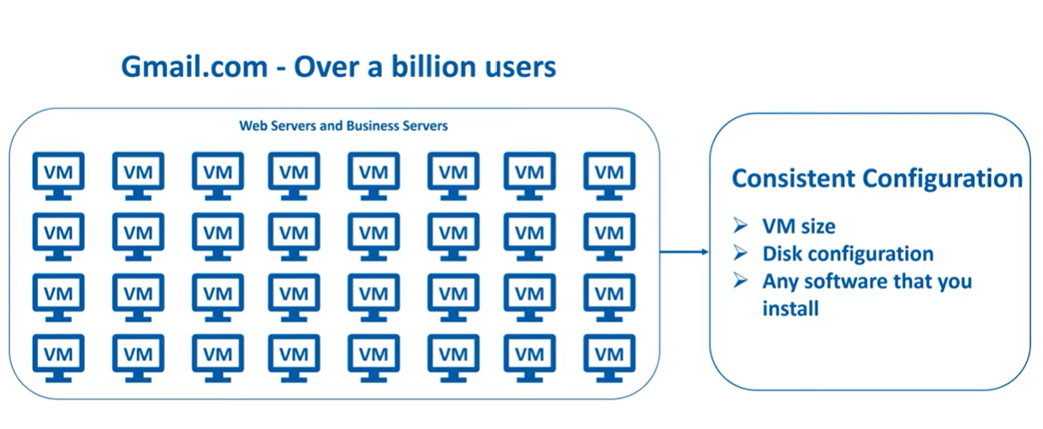
Gmail example:
→ VMSS helps to time and autoscalling.

Slide 48
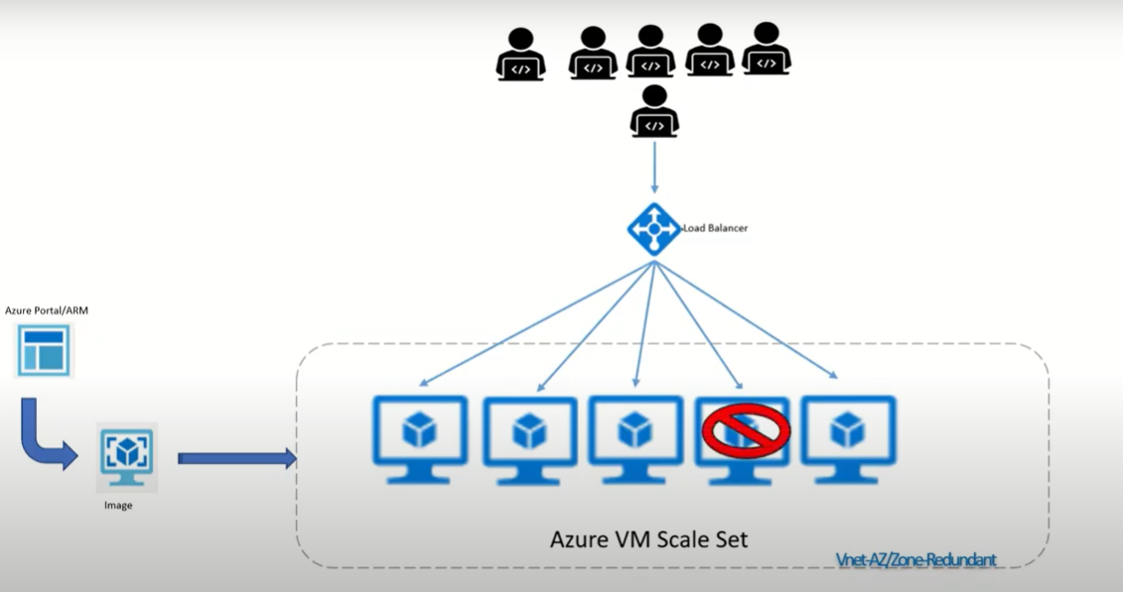
Vmss:

Slide 49

Scaleset autoscaling:
→ Create vmss.

Slide 50

AD: Microsoft multi tenant, cloud based directory and identity management service that combines core directory services, application access management and identity protection into single solution.

Slide 51

Windows AD vs Azure AD: windows AD contains domain services, light weight directories, federation services, certificate cervices, rights management services as well. But in AD we have only aad, IAM.
This both works more or less works as the same but windows ad we have more layers where everyservice will give as different layer or different way of handling it. AAD simplifies things.
Windows AD will takes ldap for communication but AAD will use rest api’s of azure.

Slide 52

Active directory:
What is AD:
https://docs.microsoft.com/en-us/azure/active-directory/fundamentals/active-directory-whatis

Slide 53
Users: all users will show here.
For creating user we need a domain in custom domain names of the AD. And that domain should be registered in our dns.
Custom domain: we can create new domain but can’t verify due to we don’t have dns set up. Once we created the dns to that domain, then only it will work.
Create Azure active directory: we can create more directories.
Groups:
Service Accounts:
Managed Identity:

Slide 54

IAM: Identity access management.

Slide 55

IAM:

Slide 56

IAM: All the action we will gets on one operation. This one we called as role. We different build in roles from azure which have their own special actions combined.

Slide 57

Where roles can be assigned? It can assigned to a principle. Like users, groups, service principal or managed identity.

Slide 58

How it will behaves?

Slide 59

Scopes:
1) Assign on management group:

Slide 60

2) From subscription:

Slide 61

3) Resource Group:

Slide 62

4) Resources:

Slide 63

Who can assign role bindings:

Slide 64
Managed Identities:
System managed identities :
User managed identities:

Slide 65


Azure Database:
SQL database in azure is a relational database in azure. It is latest stable version of Microsoft sql server database engine.
Relational Database:
Table:
We can create a table in sql database and this is the mode of storing the data in the sql database. And within the table we input the value to appropriate columns.
If another entity comes we just input the values into it.
Also Relational database are bit more than tables. We also can define constrains.

Slide 66


Azure Database:
Query (Constrains Query):
CREATE TABLE Persons (
FirstName varchar(255) CHECK (len(FirstName)>3 AND len(FirstName)<50),
LastName varchar(255),
Age int CHECK (Age<=130)
)
Relations:

Slide 67

Deployment Models:
Single: fully managed, isolated database.
Elastic Pool: It is collection of single databases with share set of resources.
Managed Instance: It is fully managed instance of the sql server. It is mostly used for list and shift the application.
SQL Database server vs sql database:
Database server acts as central administrative point for multiple single of pooled databases. Logins, firewall, adding rules, thead detection policies and firewall groups. Total 4,096 dabases can be created.

Slide 68

Purchasing models: SQL database offering 2 purchasing models.
DTU: Database transaction using. It is Microsoft unit of performance something in middle of vcore, iops, memory, and other metrics.
Vcore: This is recommended model. We can calculate how many iops, cpu, memory. Based on that we can purchase.
Serverless model: This is also vcore model.
Why elastic pool:
This is a share capacity that must involve more than one database. For example if your database is using more on some time and less on some time we use this elastic pool.
Eg: 1) If you have 1 database of 20 DTU sometimes your user feel like slowerness. In that time if you have more than one (2 databases), your DTU’s are double. Hence the users will feel comfirt to use your app due to database is faster.

Slide 69


Elastic pool: using elastic database we can save some money.

Slide 70

Serverless: In serverless we autoscale the database. In this thing Microsoft will track your usage. For suppose your database is used till 10 PM everyday. So Microsoft will not charge you after 10 PM. This is nothing but how many hours you use the database Microsoft will charge you on that hours only.
Additional feature:
Automatic backups.
Point to time restore.
Active geo-replication.
Auto failover grops.
Zone redundant databases.

Slide 71
Demo: create database.
Install sql server management.
Connect the database.
Move to database.
Create the databse.
CREATE TABLE Persons (
FirstName varchar(255) CHECK (len(FirstName) > 3 AND len(FirstName) <50),
LastName varchar(255),
Age int CHECK (Age<=130)
)
Query
INSERT INTO Persons (FirstName, LastName, Age)
VALUES (Chandra',‘sekhar',29);
SELECT * FROM Persons;

Slide 72

Cosmos DB:
It is fully managed globally distributed multi master replication database. It is designed by low latency, global replication and high scale dbs.
It is like a document database. It is a json formate of database. It is open standard from the transferring database.

Slide 73

Key Features:
Global Distribution: Easy to distribute the database in global region.
Regional Presence: Available in 54 + regions.
High availability: 99.999% availability for reads and writes.
Elastic scale: from thousands to hundreds of millions of request/sec. But cost for some penny. It allows that scale.
Low Latency percentage: under 10 ms read/write for 99th percentage.
No Schema or indexing management: designed for no schema.
Multiple API’s: 5 types of api’s we have.
SQL (A core API): this is default one. Very similar to normal sql database.
Cassandra
MongoDB
Gremlin (Graphs!): If you are working on graphs we use gremilin.
Azure Table Storage

Slide 74

Cosmos DB Structure:
Database account is top level object → databases → containers (consider as tables) → items (key)
Additionally we have storage procedure, merge procedure, user defined functions.
Containers: This contains depending on the api’s. eg: collection of Cassandra, sql for sql, table for table storage etc..
Items: Similarly based on the api we choose the item collection also will be changed.

Slide 75

Request Units: This is basically how we design the performance. Compared to other services cosmos DB don’t containe cors, ram, memory etc, instead it contains RU’s (request units).
If you are reading one unit.
Insert, upsert, delete will be based on the operations the RU will increase.
Query will be more request units consume.

Slide 76


Partitions:
We can’t change the partitions after creating the cosmos DB.
2 types
Physical partitions:
SQL API: It support normal sql query

Slide 77

Change Feed:
→ It can seamlessly connect your computing resource in azure like azure functions, or streaming apps like databrics, datalake adls etc..

Slide 78
Cosmos DB:
Demo: Create cosmos DB.
Overview→ see status. → read and write region. And also find the url. → also we can find the usage. It will show the cost. → data explorer.
Create container (create database), then keep all the inputs, patrician key (this is the one the cosmos will understand how to split logically your data also how to land the data physically.)
After this we will get one db also one one single collection will be there.
Items. → we see “SELECT * FROM c” that means give all the data in the item.→ new item
{
"id": "1",
"category": "personal",
"name": "groceries",
"description": "Pick up apples and strawberries.",
"isComplete": false
}
New Item → save
{
"id": "2",
"category": "business",
"name": "reminder",
"description": "Set up meeting with Tom.",
"isComplete": false
}
Sql query to see the data.→ new query
SELECT * FROM c
ORDER BY c._ts DESC

Slide 79
Querying Demo: Create new container under the database and partition as “/creationdate”. New item
{
"id": "WakefieldFamily",
"parents": [
{ "familyName": "Wakefield", "givenName": "Robin" },
{ "familyName": "Miller", "givenName": "Ben" }
],
"children": [
{
"familyName": "Merriam",
"givenName": "Jesse",
"gender": "female", "grade": 1,
"pets": [
{ "givenName": "Goofy" },
{ "givenName": "Shadow" }
]
},
{
"familyName": "Miller",
"givenName": "Lisa",
"gender": "female",
"grade": 8 }
],
"address": { "state": "NY", "county": "Manhattan", "city": "NY" },
"creationDate": 1431620462,
"isRegistered": false
}

Slide 80
New Item:
{
"id": "AndersenFamily",
"lastName": "Andersen",
"parents": [
{ "firstName": "Thomas" },
{ "firstName": "Mary Kay"}
],
"children": [
{
"firstName": "Henriette Thaulow",
"gender": "female",
"grade": 5,
"pets": [{ "givenName": "Fluffy" }]
}
],
"address": { "state": "WA", "county": "King", "city": "Seattle" },
"creationDate": 1431620472,
"isRegistered": true
}

Slide 81
Select Queries:
Query-1:
SELECT *
FROM Families f
WHERE f.id = "WakefieldFamily“
Query-2:
SELECT c.givenName
FROM Families f
JOIN c IN f.children
WHERE f.id = 'WakefieldFamily‘
Query-3:
SELECT {"Name":f.id, "City":f.address.city} AS Family
FROM Families f
WHERE f.address.city = f.address.state
Query-4:
SELECT [f.address.city, f.address.state] AS CityState
FROM Families f
Query-5:
SELECT value COUNT(child)
FROM child IN Families.children

Slide 82
Replicate Data Globally: We can replicate data very eaily. We just select and replicate.
Default Consistancy: 5 types we have
session: even cross region. When ever we read and write it always come at the same time. Other regions the difference will be there, but come with same order.
Consistant prefix: the request will come in order, but persistant is little less in all regions.
Eventual: It designed to quick but looses the order.
Bounded staleness: here we can configure that we can deliver your data in other region with some time. It will go with order and rate also good.
Strong: it is the stronges consistacy we have.
Firewall: Vnet integration.
Keys: we can restore the keys at any time.
Native integration with search service:
Native integration with functions:
https://github.com/MarczakIO/azure4everyone-samples/tree/master/azure-cosmosdb-introduction/demo-3-families-sql

Slide 83
Paas Mysql:
Create paas sql database.
Download workbench with following:
https://dev.mysql.com/get/Downloads/MySQLGUITools/mysql-workbench-community-8.0.29-winx64.msi
create database db1;
use db1;
CREATE TABLE customers
(id int(10),
name varchar(50),
city varchar(50),
PRIMARY KEY (id)
);
ALTER TABLE customers
ADD age varchar(50);
insert into customers values (101, 'chand', 'hyd');
delete from customers where id=101;
SELECT * FROM customers;
drop table customers;
https://study.com/academy/lesson/mysql-commands-list-examples.html

Slide 84
Postgresql:
Create postsql from portal.
Install pgadmin4
CREATE DATABASE dbname;
\c testdb;
KeyVault:

Slide 85

ADLS:
Data storage solution designed for big data analytics.
Gen2 has been evolved from gen1 which is azure build in blob storage.
Gen2 is inhirated from azure blob storage but still some of the feature which are not supported such as encryption, soft delete, versioning, and customer provided keys.
The structure is typically like file storage. And it is compatible with hadoop. That’s the reason it is used in big data analysis.

Slide 86
Feature of ADLS:
Hadoop compatible
POSIX Permissions: It allows accessing the files and directories in the storage with acl’s.
It is cost effective.
Optimised driver.
Access Tiering (Hot, cold and archive)
Demo:

Slide 87

Azure Data Factory:
It is service delivered by azure that allows you to create data integration in multiple sources of data. In simple it is a service that allows to move data from one to another service in azure.
EG:

Slide 88

Data Factory: See the diagram for understanding the flow of data factory.

Slide 89

Data Factory: Sometimes it would be more than one activities, that you see in second diagram. The following is sources are different in all the activities.

Slide 90

Data Factory: If the data is pulling in single source, then the diagram would be…

Slide 91

Data Factory:
Demo: Prerequisits are data factory, storage account, sql database.
Go to storage account → create container “input” and access is private→ upload file “cars.csv”.
url: https://github.com/MarczakIO/azure4everyone-samples/tree/master/azure-data-factory-introduction.
Demo:2 Perametrization:

Slide 92

Data factory:
If you want to load another table with same scenario, we need to create one more copy activity. For suppose if we have 100 of source and destination we have to create 100 activities. That is not the best solution.

Slide 93

Parameterize: If we parameterized the dataset we don’t need to create that many activities. We need to pass dynamic value in the pipeline like cars.csv for cars table and planes.csv for planes table.

Slide 94

Parameterize from the pipeline:

Slide 95
select * from cars
select count(*) from cars

Slide 96

Data Bricks: Azure Data Bricks is one of the leading technologies in big data technologies.
It is a big data technology that Microsoft brought one of the services in azure.
It is very cool platform that is based on apache spark.
Apache spark is one of the leading technologies in azure, so it really promises the fast transformation.
Since it is based on the apache spark, the following we will get.
Spark SQL Dataframes: This is library that allows you to work on your structure data.
Streaming: If you are doing IOT or live data. This is one of the example.
Machine Learning:
Grafx: Social media site we use this one.
Everything is based on spark core api, which means we can use R, SQL, Python, Scala, or Java.

Slide 97

Data Bricks:
Workspace: where you and your team work together.
Workflows: If you have multiple scripts we can combine them in work flows. Nesting the scripts, scripts call another scripts etc.. Simply etl.
DBIO: Databricks input output library. This allows you to easily connect multiple services in azure.
Data Bricks server less: We can get servers very quickly. Like cluster managemet.
Enterprise security: databricks well integrated with azure and azure AD. So roles and role binding and mfa is possible.

Slide 98

Data Bricks:

Slide 99

Data Bricks:
Scenario:

Slide 100

Data Bricks:
Demo: Create data bricks, and blob storage.
Create cluster.
Demo-3: Notebook: --> workspace → user→user→ right click then create notebook. → create.
Default script
Demo-4: : Notebook: --> workspace → user→user→ right click then create notebook. → create.
Secret scopes: these are secure storage for your credentials and sensitive information about your application.
Why we need?
→ If we have written notebooks and keys are present in the code, then it is security issue. To avoid we need secret scopes.

Slide 101

Databricks:
How it works:
Basically we have secret scopes will be there on data bricks and each scope we will be have secretes.
Storing the scret scopes and secrets will be in 2 types one will be internal database of the cluster and second is azure key vault.
We can have access to each scope to users and groups for better security.
We can use azure databricks cli. Also we can use keyvault.

Slide 102
Databricks:
Permissions levels:
Manage: allowed to change acls, read and write to the secrete scope.
Write: allowed to read and write the secrete scope.
Read: allowed read the secret scope and list the secrets which are there in the secret scope.
Demo-: install databricks cli.
databricks –h
pip3 install databricks-cli
databricks configure –token it will ask databricks host → past the url of the databricks → then, go to your user settings → generate token. → copy token.→ paste the token in the terminal.
databricks secrets list-scopes
Create scope
databricks secrets create-scope --scope myblob
databricks secrets list-scopes
## create secret on the scope ##
databricks secrets put --scope myblob(scope-name) --key demokey(keyname) → it will open up the notepad paste the access key and save.
databricks secrets list --scope myblob (scope-name)
To see key → create notebook with scala→ enter the following in the block.
val blobaccesskey = dbutils.secrets.get(scope = “”, key = “”)
val insecure = “123”

Slide 103
Databricks:
databricks secrets list-aclss --scope myblob (###shows the acls on the scope)
##provide the permissions
databricks secrets put-acl --scop myblob --principal <adUser/group/sp..> --permission READ
### keyvaults: ###
Databricks url#secrets/createScope → we can create scope from here.
Provide the name, dns name is key vault dns name, and resource id is key vault resource id.
You notice one thing, under keyvault access policies, the application will be created automatically. That means acces to key vault is already there.
Now enter
databricks secrets list-scopes
After this you can create secrets from the key vault it self.
Demo: show the jobs, user permissions, and acces..

Slide 104
Azure App Service plan / app service environment:
Without app service plan we cant create app service.
App service is web application and app service plan is compute for the app service.
SKU: 3 types
dev/test
Production
Isolated:
Isolated we also called as azure app service environment.
App service environment: It is like a environment where our apps can run on a particular private network.
If you want to secure your applciaiton we can use app service environment. So the flow is
App service environment → app service plan. → app serive. → Slots → Deployment.
In environment we can have custom dns from environment end.
Also can have certificates and so on…

Slide 105


Azure App Service:
Overview:

Slide 106


Azure App Service:

Slide 107

Azure App Service:
Scale up scale down:
dotnet new mvc
dotnet run
→ home→Views →index.html (change it.)

Slide 108

Function app: This is serverless.
Function app is a service which runs the small pieces of code.
It has native integration with azure app services also. That means we can use the big application deployed on azure app service and small piece of code can run on azure functions.

Slide 109



Function app:
Key Features:
→ It is pay per use model. If we are going for serverless the price is super cheep. That is first 400000 gb/s and 1M executions are free.
But if we are going for ASE model or ASP model we need to pay for the compute power.
Simplified integration, flexible deployment etc..
We can develop the code from portal or vs code or other tools as well.
Integration with GitHub, Azure DevOps etc…
How it works:

Slide 110



Simple example: We want to process the code of blob storage and keep into another blob storage.

Slide 111



Function app:

Slide 112

Function app:
Triggers and bindings for function app:

Slide 113
Function app:
Demo: Create function app and explain.
Create function from portal from http trigger. → explain the option on the same.
Code+test → find the default code. → find the responsemessage code and explain about it → test/run → run → check the output, it should match with resposemessage.
Get function url → copy it → append with &name=devops → we will get the response which again matches with resposemessage in the code.
If you want we can change the respose message code.
Demo from VS code:
Create other function app
Fn f1 → create function → http trigger → name of the trigger → namespace default → admin → it will create project
Change the local.setting.json → and deploy → also check the logs

Slide 114


Azure Logic Apps:
When it comes to integration across multiple services in azure it is the best service.
Logic app allows you to schedule, automate and orchestrate the tasks. That means you are creating flows to do some work like etl, email
How it works:
Every step of logic app is action.
Like action followed by action followed by action.
It also has capability of conditions as well.

Slide 115

Logic App:
→ Each action in the logic app is contains input as well as output.
Eg: Imagine we are working on persons table person in input in first action, output is age, name. 2nd action we can take one or more previous outputs and filter it out. In 3rd action we can take outputs of first 2 actions. That means we can combine 2 action outputs in the final action.

Slide 116

Logic App:
→ First action in logic app is a trigger. This invokes the entire flow.

Slide 117


Logic App:
Eg: http trigget and http response.

Slide 118
Logic App:
Demo: Explain about difference b/w standard and consumption logic app.
Create a consumption logic app.
We can see different triggers and some templates as well on the home page.
Click on blank logic app, → request → when http request received → add new perameter, select method → select get
Clic on + button for new action → type response → in body type “Hello World” → save → run
Go to overview → click on that activity.
Go to designer and run with payload → copy the http trigger and hit in the browser. We will get another run.
Go to code view to check the code what ever we have designed.
Click on version → each time a run happened there is a new version will be created.
Go back to designer → add new parameter, Relative path → /{name} → save
Go to the path again → copy the http path → notice one more invoke option is there → but we change it will not work at all.
Go back to logic app → in the respose option paste the dynamic content called “name”. → now the url → do the same like earlier. Now it will work. → now the http value will be changed.

Slide 119


Logic App:
Demo-2:
Create storage account.
Create container called log.
Go back to logic app designer.
Add step b/w request and respose.
Add action → type blob → select azure blob storage → then find our action, create blob v2 → define the connection, blobconnection → connect with keys→ select the path → blob name as “name”.txt. → keep any content. → once we run. We will get a file in the blob container.
Demo-3:
Create new logic app
Designer → blob → add trigger
Provide connection name → select container log
Change interval 3 to 1
New action → office 365→ send email → authoticate.

Slide 120

App Insights:

Slide 121

Service Bus:
→Service bus is effectively a message sender or collector.
Why we need service bus:
Image you have a offer to book a flight ticket, back in days we were using monolithic application. That is not good user experience app. So went away of the app.
Eg: If you are using a micro service architecture, we need to deal different microservices to complete a transaction. And each and everything has to go like a flow. Else our app is not working properly. If any time in middle the transaction cancelled, the complete transaction will be cancelled.

Slide 122


Service Bus: We have 2 types
Queues
Topics
Queues:
It works like FIFO. First in First out.
Topic:
This contains something called topics, subscriptions.
Topic is a high level entity.
Each subscription will listen to topic and takes the
messages, and send it to process.

Slide 123


Service Bus:
Without Azure service Bus:
With Azure Service Bus:

Slide 124
Service Bus:
Dead lettering: If the queue is not processing then the queue will go to dead letter queue.
Sub Filtering: We can do some sub filtering on the topics or queues.
Message sessions: Allows you to say that the group of messages will processed in a session.
Scheduling: We can schedule the messages later based on our requirement.
Duplicate message detection:
TTL: time to leave, allows you to say that. If in a specified time the message is not published, then we dn’t need to care on this message. The transaction is automatically cancelled.
Topics:

Slide 125

Topics:
Create service bus
Create a topic
A topic can have one or more subscriptions
Create 2 subscriptions postsubscription, videosubscription
go to postsubscription
Click on filters → add filter → create one with postfilter name.
2 types sql filter and correction filter
Click on correlation filter → key as ‘label’ and value as ‘post’. → save changes.
Go back to subscription -→ create filter for videosubscription. → Now in correlation filters key as ‘label’ and value as ‘video’.
Go back to topic and click on service bus explorer → In send option → content type ‘text/plain’ → some message content in the box → click on collapse advanced properties → in the label enter ‘post’ → send it.
Again send another message → test/plan → some message content → this time labels as ‘video’. → send it.
Click on peek (this is like sending message)→ select the subscription → shows how many messages on that subscription → then click on peek.→ it will go to subscription queue → and we can see the message in that.
Receive means collect and process the message as well. Hence the message will be deleted.

Slide 126
Search Service:
Search is very imp feature in most of the applications which has some data.
And all our data will be from some kind of data bases which would be databases or any other data sources (storage).
SKU:
Storage: how much size of the storage we have to storage the indexing information. It is varies 50MB to 2 TB based on the sku.
Index: This is the actual data. Table of data etc….
Indexer: Indexer is the one who created index.
Replicas: This is the one which duplicates our data in multiple locations like central us, west us etc…
Partition: It is like a drive, where we can store indexes. Each sku may have one or more partitinos.
Eg: storage = 200GB/partition
Total partitions = 3
Total storage = 600 GB
Partition is splitting the data in different locations in a data centers like drives or any other storages.
Search unit: The total no.of search units for a particular sku or search service.
Advantages:
It is paas service. So all compute, patching etc.. We don’t need to worry.
It does the full search. All columns rows of data will be searchable. Also can do filtering.
It supports up to 56 languages.
Data integration: We can use json, xml, sql language, etc....

Slide 127
Demo:
Create congnitive search.
Click on import data
Select samples and then select sql database
Then there it self create index and indexer
Wait till indexer status is success, then only the data is synced to the search service
Click on index
In the search explorer select * then search
It gets all the data.
Create demo app
Select cors option.
Create demo app
Go to home path and search with * option. Everything will be appeared.
Finally explore that page.

Slide 128

Azure Monitoring:

Slide 129
Azure Monitoring:
What data it collects:
Azure platform services: like service health.
Infrastructure: VM’s, app services, db’s etc… This requires agent to collect logs of the VM’s to guest os (OMS agent). These vms can be azure, other cloud or on-premises.
Application: Any language application logs azure monitor can collects.
Custom services: Any rest api’s logs also it will collects.
Where to collect:
All the logs will be collected in azure in metrics or logs. After that we can analyse the data.
Metrics: Metrics are stored in time series database, and lightweight and capable of supporting real time scenarios. It makes fast detecting the issues.
Logs: We can analyse the logs of the resources with powerful query language. There are specially used to perform complex scenarios.
Analyse: Once the data is collected the analyzer will analyze our data.
Virtualization: We have dashborads and workbooks to visualize the data.
Respond: This comes under alerting part.
Insights: We can use insights and monitor the url monitoring.
3rd party integration: we can integrate these to 3 party tools.
Action Group: this contains email address or webhook or automation what needs to be done on that alerts.

Slide 130

Load Balancer:
Load balencers are 4 types in cloud
Load Balencer
Traffic manager
Front Door and CDN profiles
App Gateway
Load Balencer:
This is service in azure for efficient traffic distribution
How it works:
Scaleset is the perfect example for this one.
Scaleset can add upto 1 to 100 servers at a time.
→So our job to loadbalence the application.
→ We can do that using load balancer.

Slide 131

Load Balancer Items:
Front end Ip configuration: It is public or private ip.
Backend: Group of servers handling our request
Health probes: Monitoring the backend pool health. Why means our loadbalencer needs to know weather our backend pools of ok or not.
Load balancing rules: traffic distribution to backend pools.
Inbound NAT rules: binding of specific IP/port to specific instance in backend pool.
Outbound rules: Controls the outgoing traffic.
If you are using scaleset, the backend is automatically updates. So we don’t need to worry load balancing.
But if we are using availability set we need to manually attach backend pool when ever new server created.
N Tier application:

Slide 132


Load Balencer:
Standard vs basic load balancer:
Different b/w other services:

Slide 133
Demo:
Build the infrastructure using code.
https://github.com/MarczakIO/azure4everyone-samples/blob/master/azure-load-balancer-introduction/environment-create.sh
Once VM created, check the VM. It should not have public IP. Go to run command and type the following command to get the result what is currently running on the VM.
curl localhost –usebasicparsing (we can see the output as "vm-eu-01“, same for other VM’s)
Create public load balancer with basic sku.
Go to frontend Ip and we can find the public ip address of the same.
Go to backend pools → Add → associated to is “Virtual machine“, and select the VM’s.
Go to health probe → add → remaining all are default.
Go to Load balancing rules → add → provide the name → select the frontend ip → protocol should be tcp. → port is 80, backend port is also 80, → select our backend pool → select our health probe → session persistent is None. → click on OK.
Session Persistant:
None: No reservation to the backend pool ip’s. That means every time we hit the url, we will get the different server output.
Client ip: It is like a reservation of IP. Even we have different backend pools, we reserve a particular ip address, so that everytime we run hit the url we will get the same out put.
Client ip with port: same like client ip, but it contains port as well.
→ After set up is done we can see the public ip has been attached to vm’s. we hit the vm, each time we will redirect to different app.

Slide 134

Traffic load balancer:
Dns based load balancer
How it works:
It works like a end points.
**Once everything is set up, traffic manager route the traffic in 2 factors.
Routing method which we selected.
Health of the end point.

Slide 135


Routing methods:
Permormance: It is like a closest end point. You live in india, so you will be redirecting to india a lot.
Weighted: we establish a wait for each end point.

Slide 136


Geo graphical: some legal reasons entire universe can be redirected to some region but some users only has to redirect to some region (navy data, army data)
Priority based: good on dr activity. Provide priority based on priority it will go.

Slide 137


Multivalue: here only we can use ipv4. we add ip’s then the routing will go as required.
Subnet: all the subnet ip user/resources go to one region and remaining will go to another region.

Slide 138

End point monitoring: traffic manager will monitor all the end point for our backend services.
Netsted endpoints:
Traffic views: we can see where our traffic is coming.
Real user management:
Metrics and alerts:

Slide 139
Demo:
Create infra using script
Go scm urls of the app services and update the html pages and check working condition.
Create traffic manager with performance routing option.
Once traffic manager created we can find the dns url from overview page it self. Also we want we can disable the traffic manager for sometime.
Go to end points. →add → create 2 end points one for east us and second for central india. → wait till end points status changed to online.
Then put the dns url in brouser, we will get the central india url.
Then login to servers and check dns url in the server. It should give similar result.
Go back to traffic manager → configuration → change performance to waited → now it should redirect url based on waitage provided.
Geographic:
→Go back to traffic manager → delete the end point due to the end points doesn’t have geographic onfigured.
Go to configuration and change routing method to geographic. → save.
Go back to endpoint → add → now while creating select north America, united state geographic option will be with east us.
Again add endpoint → now regional grouping is central india. → and it should work the same way.

Slide 140

Azure Application Gateway:
Application Gateway provides WAF and load balancer.
This works on layer 7 but where in traditional load balancer works on layer 4.
App gateway makes routing decision based on the url or request.
In above diagram if the url contains images, the request go to images pools and if the request is with videos then the request will go to videos pools.

Slide 141

Features:
Ssl/tls termination
Autoscaling
Zone redundancy
Static ip
Ingress controller for AKS
url based routing
Multiple site hosting: Each web application gateway easily can support 100+ websites.
Redirection: Automatically configure http to https redirection.
WAF: consists of different set of rules, that can protect your entire application from different kind of attacks like sql injection attacks or cross side scripting attacks etc..
Session effinity: It allows coockes based effinity.
Websocket and http/2 traffic: port 80 and 443 support.
Connection draining
Custom error pages
Rewrite http headers and url
Sizing: standard v2 most of the feature will be supports.

Slide 142

Azure Application Gateway:

Slide 143

components:

Slide 144

CDN and frount Door:
CDN: this is a load balancing solution to the world where we can retrieve the application much faster due to edge location.
The way how it works is initially the application or data will be copied from the source region to remaining all azure regions we called them as edge locations. So next time if you hit again the same application the data or site we will access from your near location.
Demo: Create a azure app service.
Create container and made like a public.
Upload some files
Access it from internet.
Now create cdn
Create end point
Now open the website by changing with cnd end point.
We can clearly see the website response.

Slide 145


Slide 146

Azure DNS only helps to manage the dns from the azure.
DNS (Domain Name system):
This is a protocol within the tcp/ip standard.
It translate domain names into a ip addresses. This is because we only remember words rather than ip addresses to reach a website.
How DNS works: There are 2 primary function that dns server will do.
DNS record types:
A record: This is most common type of dns record. In this record we made domain or hostname to the ip address.
CNAME record: CNAME means canonical record. It used to create alias for the domain name. It is like alias from one domain name to another domain name. For example if you have different domain names accessing the same website we can create cname record there.
MX record: This is for the mail exchange record type. It maps the incoming mail request to the specified mail server weather hosted on-prem or cloud.
TXT record: This is the text record. This is associated to the domain names to verify the domain ownership. It helps on map domain to any of the azure resource like app service, or azure ad custom domain etc…
Wildcards Record:
CAA record:
Name server record: This will automatically created when we created azure public dns zone using azure dns.
Start of authority record (SOA): This will automatically created when we created azure public dns zone using azure dns.
Sender Policy Framework (SPV):
Sender Locations (SRV):

Slide 147

Record Set: There may be instances there are different instances will mapped to a single record. Eg: one domain will map to 2 ip addresses. This we called a record set. But this can not be done with CNAME or SOA record types.
What is azure DNS: Azure dns manages the domains in the portal. But it has to register by some other third party apps like GoDaddy or someone.
That means azure dns can not register the domain in its own.
Features of Azure DNS:
Provides improve security feature: Like RBAC, and we have activity logs that lets you track the activities which are performed on the azure dns. Provides resource locking. Also it is ease of use.
Demo:
Create app service and get the url.
Create dns zone resource in cloud with same name of our domain.
Update nameservers of godaddy to nameservers of azure dns zone.
Create A record with name @ and ip is app service public ip.
Create CNAME record with name www and alias as app service dns name.
Check our custom url, it will change ui page but not propagate properly due to custom domain is not yet created on app service.
Go to app service, create custom domain then validate. It will not validate the ownership, the create the txt record in the azure dns zone with name as host name and value as domain id.
Then add those domains. Now the app will work as is.
Then clean up resource also change the azure nameservers of Godaddy default nameservers in godaddy dns management.

Slide 148

Private DNS:
This helps to create the custom domains.
This domain name that may or may not be register with your domain registar.
If registered and if you are registered with public dns, the we can configure both public and private dns zone.
→ The DNS records private dns are not retrievable or viewable.

Slide 149

Private DNS zone benefits:
Removes the need for custom dns solutions. Many org have to use custom dns zones in the private network. With private dns zone we don’t need that.
We can use all dns common records types.
Automatic host record management.
Host name resolution b/w the vnets.
We can use automation tools to manage this.
Split horizon dns support. (both public and private)
It is available in all the regions of azure.
Private DNS zone scenarios:
If you need to resolve the resources in vnets using a specific domain name.
Also we need maning resolution will be private.
Automatically register the vm’s into the dns zone.
We can do name resolution for multiple network.

Slide 150

Split horizon view:
Demo: Create 1 vnet and create 2 servers in it with public ip’s.
2) Create private dns zone with some domain. Default SOA will be there.
3) In private dns → virtual links → name, provide the vnet → enable auto registration (require ) → vm1 and vm2 will be there as the record sets.
4) If we click on one vm we can see the host name.

Slide 151

Arm Template:
How it works:

Slide 152

Arm Template:

Slide 153

Arm Template:

Slide 154

Arm Template:

Slide 155

Arm Template:

Slide 156

Arm Template:

Slide 157

Arm Template:

Slide 158

Arm Template:

Slide 159

Arm Template:

Slide 160

Arm Template:

Slide 161
Arm Template:
Parameter File:

Slide 162
Azure CLI: azure cli is cross platform commandline experience to manage the azure resources.
Common scenarios:
Day to day operation
Infra build
Devops etc…
Some common commands:
Why use cli:
Easy to start
Cross –platform
Works on different ide’s

Slide 163
Azure powershell:

Slide 164
Azure powershell:

Slide 165
Azure powershell:

Slide 166
Azure powershell:

Slide 167
Azure powershell:

Slide 168
Azure powershell:

Slide 169
Azure powershell:

Slide 170
Azure powershell:

Slide 171
Azure powershell:

Slide 172

Ingress:
path: /videos like more paths in a url.
Host: url (we need to keep this into hosts file)
http: this is redirects to load balencer/cluster IP (service) of the application (POD)
Service port: port number of the service
Install ingress controller (new pod)→ write ingress file → ingress point out to service.→ this is how the application will be accessed.
Kube-system

Slide 173

Ingress with path:

Slide 174

Ingress with different hosts:
Kubectl create service account <service account name> -n ns

Slide 175

Tls/ssl:

Slide 176
Azure devops variables:
Variable groups are groups of variables that could be applied in one or more yml files. We can add different values. We can integrate variable groups into azure keyvault.
Pipeline → libraries → variable grop
trigger:
- master
Variables:
name: variable name
value: variable value
-group: <group name>
name:
value: pool:
vmImage: ubuntu-latest
steps:
- script: echo Hello, world!
displayName: 'Run a one-line script'
- script: |
echo Add other tasks to build, test, and deploy your project.
echo See https://aka.ms/yaml
displayName: 'Run a multi-line script'

Slide 177
Stages: minimum one stage will be there in azure devops pipeline. Each stage have one or more jobs. Like build, deploy, …..
Stages → stage → jobs → steps → script (if any)
Stage: like build stage…
Job: It is a collection of series of steps perform to complete one stage. Job is smallest building block on a agent.
Azure devops branching stategy:
Azure devops service connection for kubernates:
Service connection → kubenetes → 3 options, one is service account → select service account → take server url from kubenetes → paste the secret value as json in the box → provide the service connection name → choose the granting permissions.
Kubectl get service account -n <serviceAccountName> -n namespace
Kubectl get service account -n <serviceAccountName> -n namespace –o yaml
####Get the secret name#####
#### for creating service account use the following ####
Kubectl create service account <name of the service account> -n <namespace>
Kubectl Cluster-info take kubernetes control plan url for server url.
Secret: get the service account secret in json formate use the following command
Kubectl get service account -n <serviceAccountName> -n namespace -o json
### we have to create role and role binding to the service account ###
Create a role → kubectl create –f role.yml –n <ms> → this will create required role in the cluster.
Create role binding → this will bind the role to service account or any users.

Slide 178
Service connections:
Project settings → service connection → create new → azure resource manager → create the servi
variables:
- group: my-variable-group
- name: my-bare-variable
value: 'value of my-bare-variable'

